Slide 1

CS 328 - Fall 2019
Assignment 3: Logistic Regression in PyTorch

Slide 2
Outline:
Logistic Regression
Loss function
Regularization
Datasets
Implementation Steps

Slide 3
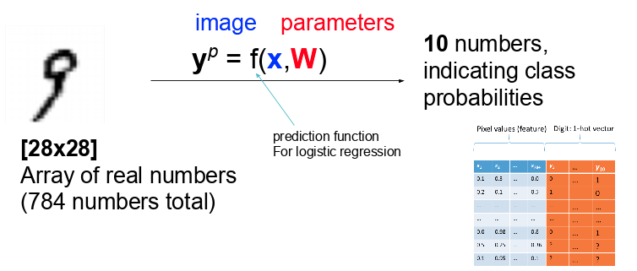
Logistic Regression:

Slide 4
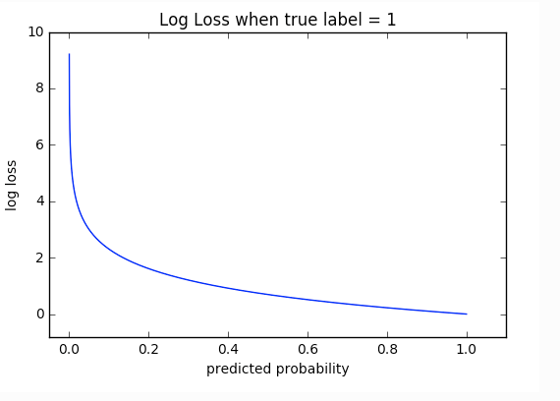

Loss Function : Cross Entropy
Cross-entropy loss, or log loss, measures the performance of a classification model whose output is a probability value between 0 and 1. Cross-entropy loss increases as the predicted probability diverges from the actual label.
Q: Why don’t we use Euclidean distance as before?

Slide 5
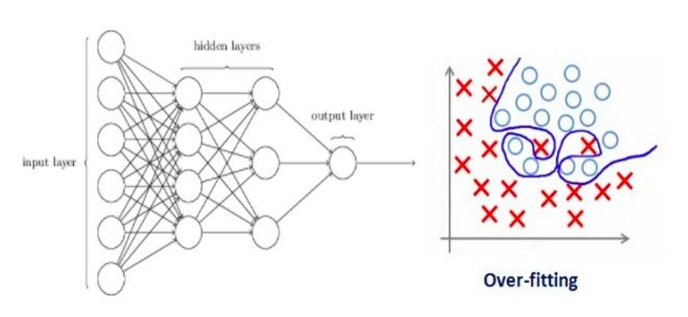
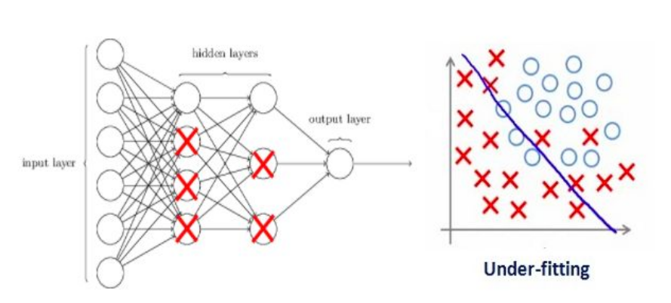
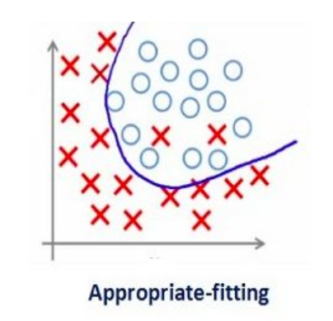
Regularization:
A way to penalize the weight matrices of the nodes.
We update the general cost function by adding another term known as the regularization term.
Cost function = Loss (say, binary cross entropy) + Regularization term
Due to the addition of this regularization term, the values of weight matrices decrease because it assumes that a neural network with smaller weight matrices leads to simpler models. Therefore, it will also reduce overfitting to quite an extent.

Slide 6
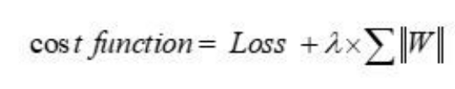
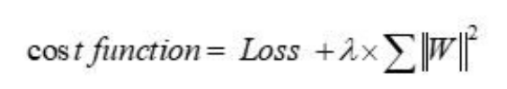
Regularization:
L1 Regularization:
L2 Regularization:
Notes:
Here, lambda is the regularization hyperparameter, whose value is optimized over the validation set for better results. L2 regularization is also known as weight decay as it forces the weights to decay towards zero (but not exactly zero).

Slide 7
Datasets

Slide 8
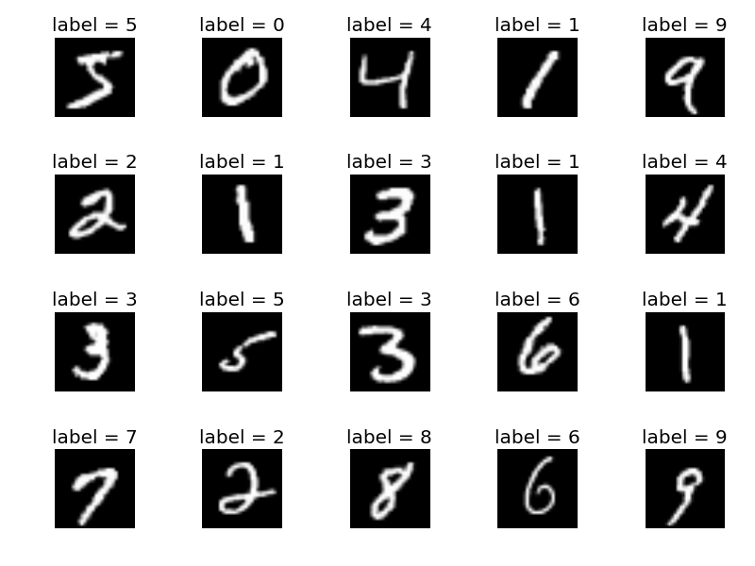
[1] MNIST Dataset
28x28 Binary images of handwritten digits
60K training, 5K testing images

Slide 9
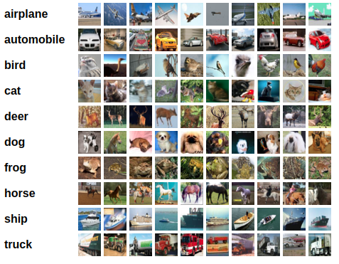
[2] CIFAR-10 Dataset
32x32 RGB images of different objects
60000 in 10 classes, with 6000 images per class, divided as 50000 training images and 10000 test images.

Slide 10
Different Data splits:
Train Data (48000), originally (60000)
Validation Data (12,000): Subset of the train data
Test Data: Shouldn’t be included in the training process, even for fine-tuning the hyperparameters

Slide 11
Data loaders:
A way to combine a dataset and a sampler, and provides an iterable over the given dataset.
To create data iterator:
dataiter = iter(trainloader)
images, labels = dataiter.next()
To iterate in a loop:
for data in enumerate(dataloader):
Image, label = data

Slide 12
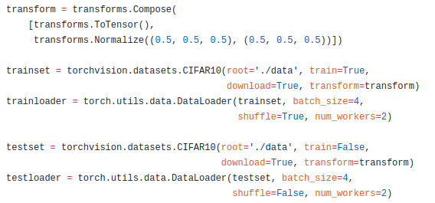
Data loaders:
An example over Cifar10 would be:

Slide 13
Implementation Steps:
Define your train, validation, and test data loaders in PyTorch
Define your model
Define cross entropy loss
Add weight regularization to the loss
Training loop
Validation after every 5 epochs
Choose your best-hyperparameters on the validation set
Test the model on the test-set and return the test-predictions from the function

Slide 14
Useful PyTorch functions:
Optimizer: Adam, SGD, etc:
torch.nn.CrossEntropyLoss
Data Loader : torchvision.datasets.MNIST, torchvision.datasets.CIFAR10
Data Samplers
torch.max(tensor)

